Slide 1
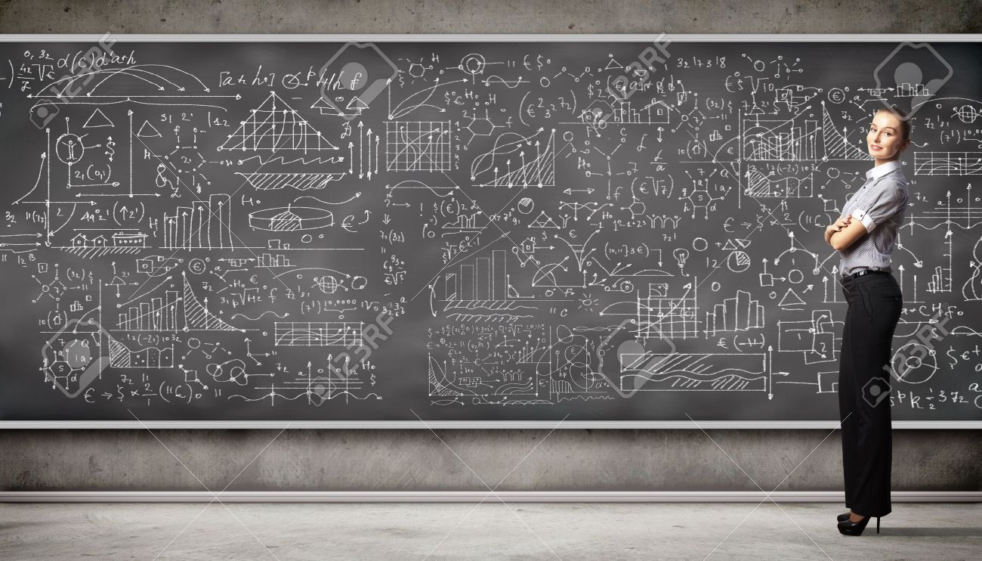
Data, Data…………
Members:
Gowsalya R – IIT Madras Shashank Gupta – IIT Madras
Pranav Kumar- BUAT Banda Devi Prasad - BUAT Banda

Slide 2
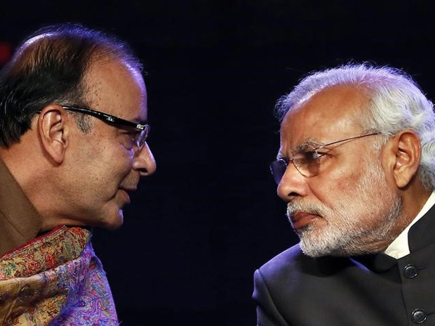

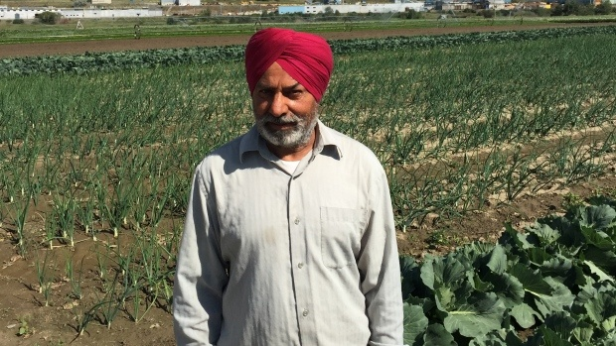
How Problems of farmers of Ludhiana and Mohali are different?
What do you mean?
How to manage my farm & revenue?
Data about our existing technologies? New business ideas?

Slide 3
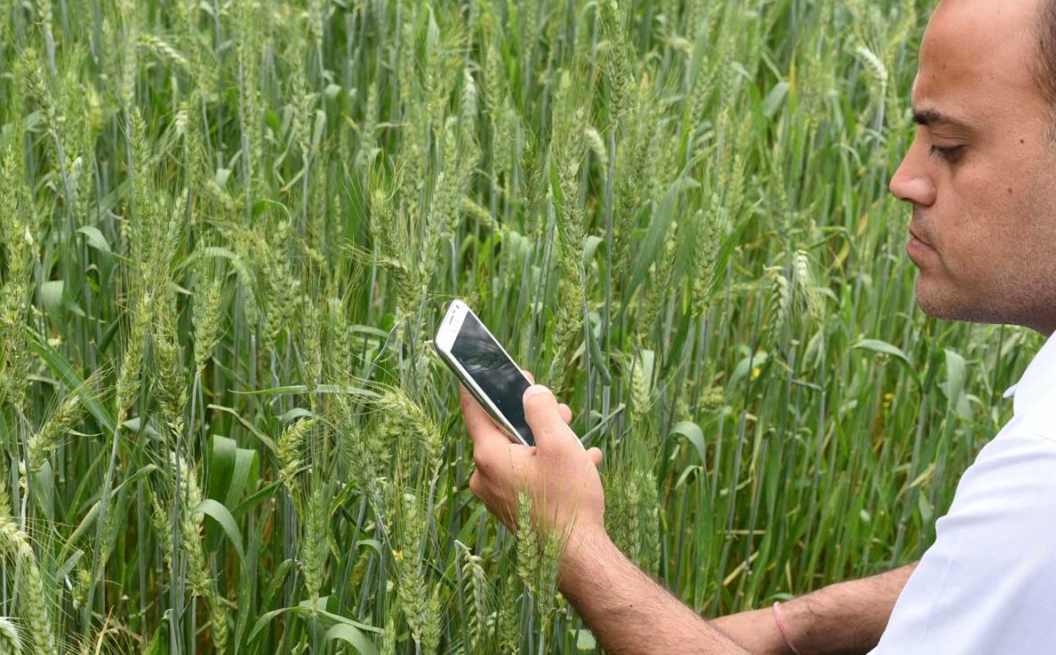
Managing farm for free
Sleek and simple UI
Recommendations
Local Language
Different Revenue Details
Comparative details
Simplified report
Market details

Slide 4

Region specific analysis of our products
Identifying new business areas
Saving time in the ground survey

Slide 5
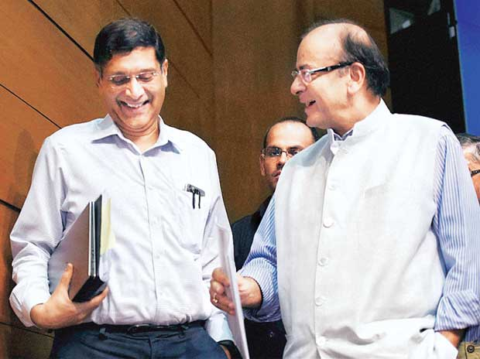
Region specific Policies
Quantitative analysis of factors in farming
Knowledge of farmer’s innovation
Identifying the most crucial factor in lives of farmers

